Slide 1
SUPRASEGMENTALS
14/02/2019
Inna Sieber
innasieber@gmail.com

Slide 2
Suprasegmentals
Prosodic units / features = suprasegmentals:
Hierarchy
Structure: nucleus, periphery, boundaries
System: not inventories but schemes
Units: foot, syllable, word, prosodic phrase, utterance…
Features: stress, lexical tones, intonation, rhythm, tempo…
Parameters: pitch, intensity, duration + phonation, quality…

Slide 3
Today:
Word stress
Lexical tones
Intonation
Types and descriptions
How to measure

Slide 4
Stress (accent)
makes one syllable of the word prominent (word stress)
makes one word in a phrase prominent (prosodic stress)
Domain (word stress):
a vowel?
a syllable?
a word?
NB: lexical stress ≠ word stress
lexical stress is word stress that can distinguish between words and word forms in a language

Slide 5
Word stress: perceptive/acoustic parameters
Loudness (intensity)
Duration
Pitch (fundamental frequency)
Vowel quality (reduction)
What parameters are responsible for stress?
What is the most important?

Slide 6
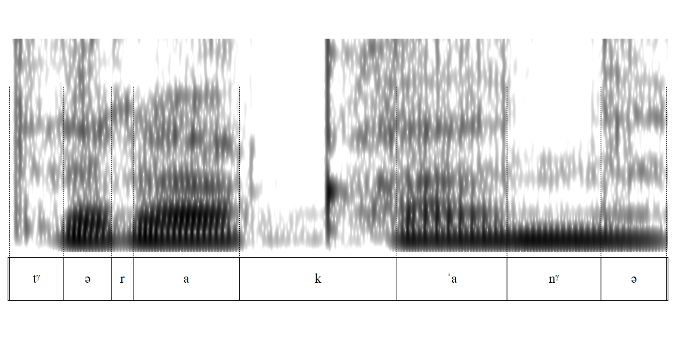
Russian: /tara'kany/ or /tara'kana/ (‘cockroach’)

Slide 7
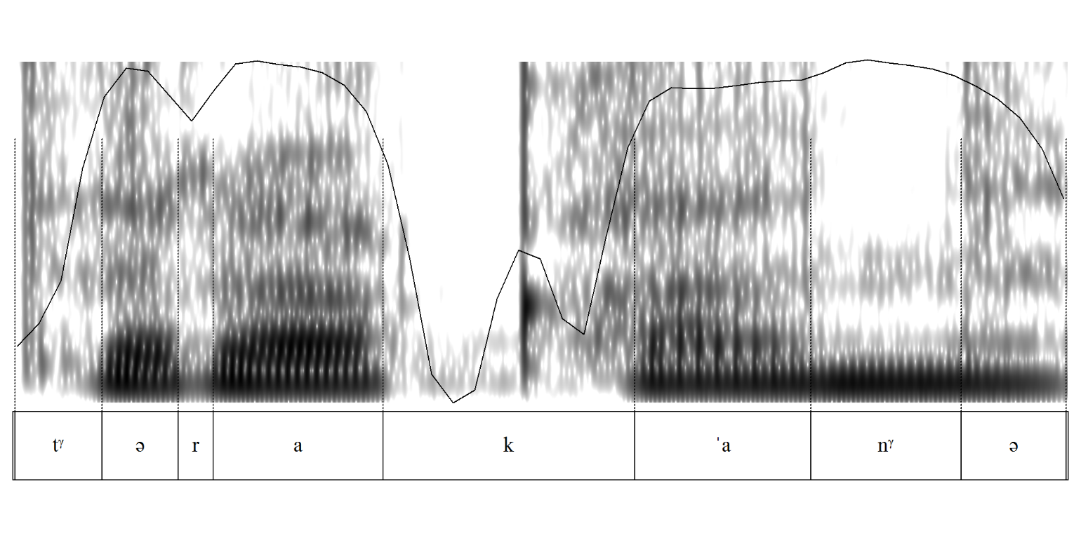
Russian: /tara'kany/ or /tara'kana/ (‘cockroach’)

Slide 8
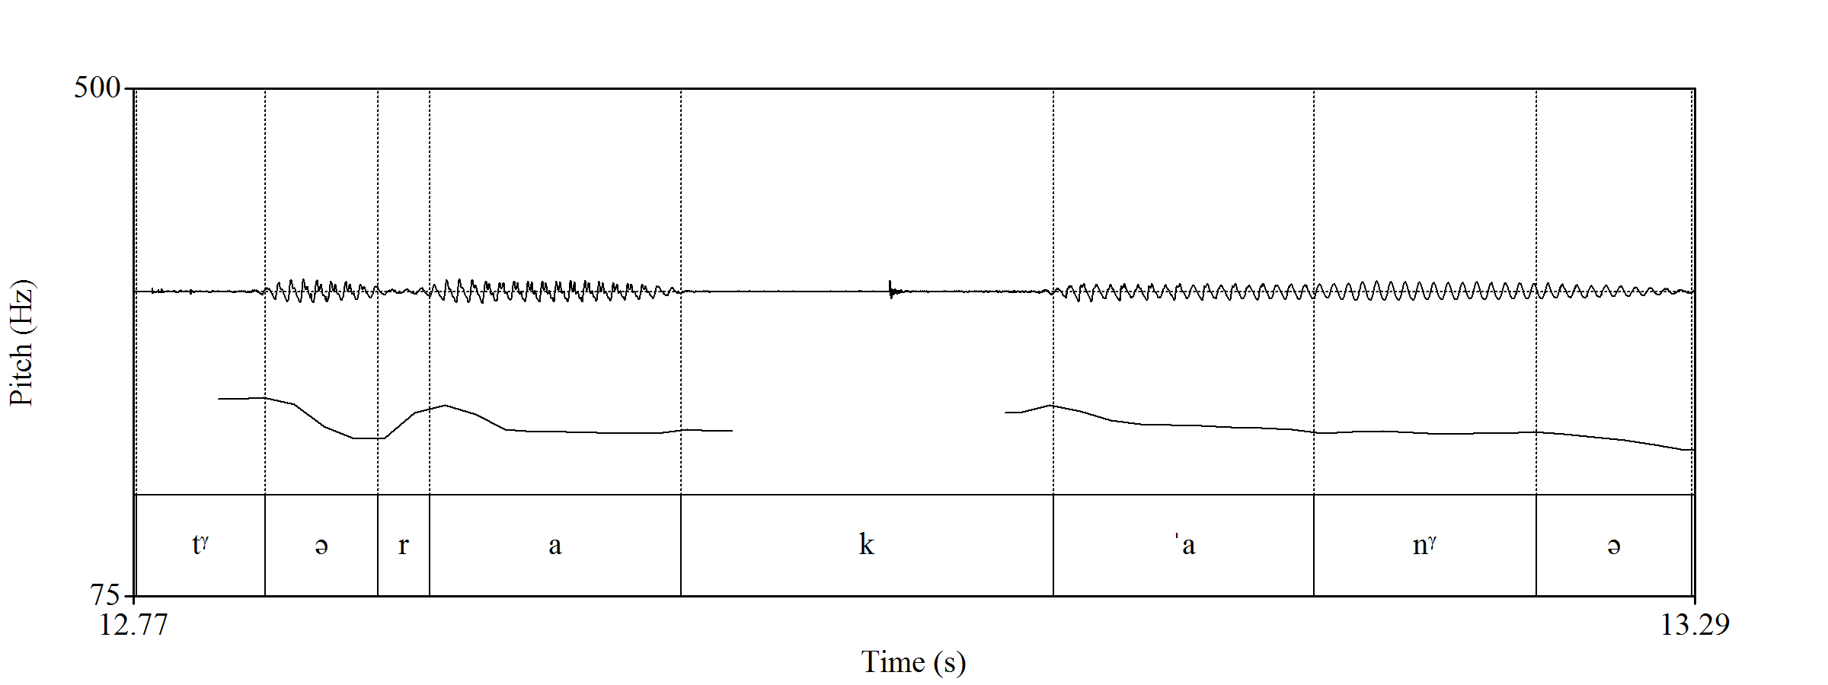
Russian: /tara'kany/ or /tara'kana/ (‘cockroach’)

Slide 9
Russian: what is prominent
Duration: pre-stressed and stressed are longer
Quality: pre-stressed and stressed preserve quality and distinction
Intensity: the last unstressed syllable is the least intensive
Pitch: initial segments have higher pitch
In Russian the “prosodic nuclear” differs in duration and quality

Slide 10
Pitch and tone
Fundamental frequency (F0) – acoustic term
Pitch – perceptual concept
Tone – phonology, a linguistic term

Slide 11
What suprasegmentals use pitch?
 | INTONATION | TONE
Domain | Prosodic phrase, utterance | Syllable
Is pitch independent | There are other parameters (pause, phonation, duration) | Independent
What is distinguished | Information structure, purpose of speaking | Words, word forms

Slide 12
Tones (lexical tones)
сan distinguish between morphemes, words, word forms
are independent from phonetic position
characterize each syllable of the word
can combine pitch with phonation, intensity and duration
In lexical tone languages tone is distinctive and it is an essential feature of morphemes, words and word forms

Slide 13
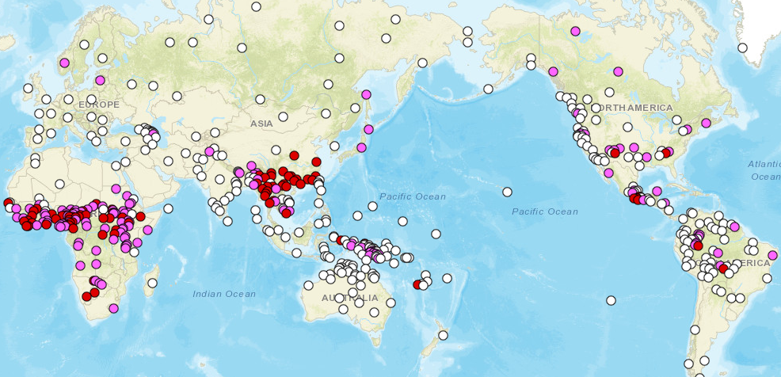
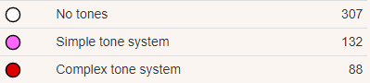

Slide 14
Tones: typology
LEVEL TONES | CONTOUR TONES
differ in pitch | differ in direction of movement
extra high, EH high, H mid, M low, L extra low, EL | Simple tones: rising, R falling, F Complex tones: rising-falling, RF falling-rising, FR + low rising, high falling etc…

Slide 15
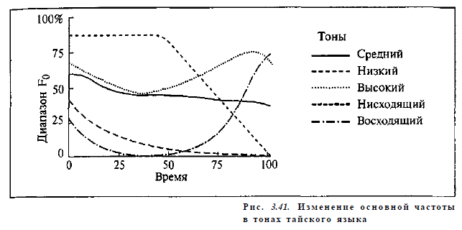
Thai level (M, L, H) and contour (F, R) tones
M
L
H
F
R
(Кодзасов, Кривнова 2001: 187)

Slide 16
Tone systems: typology
Register tone languages – level tones only
Contour tone languages – level tones AND contour tones

Slide 17
Register tone languages
Word is a sequence of level tones
Yoruba:
oba/МH ‘(he) met’
oba/ММ ‘(he) hided’
оba/МL ‘(a bird) sat’
Predictable contour tones are possible due to phonological rules
Efik:
ke urua/HLLL > kurua/FLL ‘at the market’

Slide 18

Guinea Kpelle
(1) ŋaa ɓɛlaa lɛ ma
I sheep show him
‘I showed him a sheep’
(2) ŋaa ɓala lɛ ma
I drum show him
‘I showed him a drum’
(thanks to Maria Konoshenko, 2018)

Slide 19
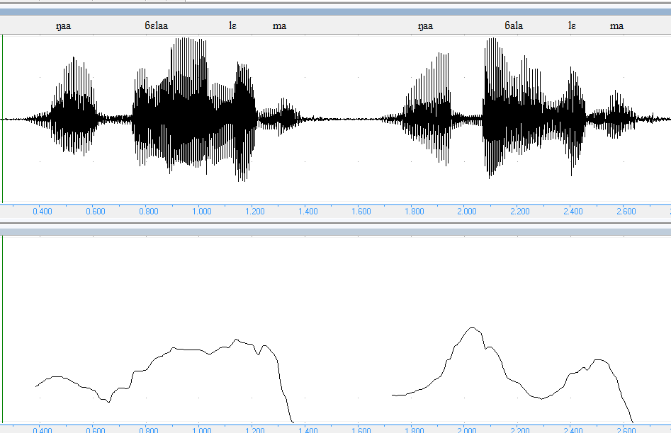
Guinea Kpelle
(thanks to Maria Konoshenko, 2018)

Slide 20
Contour tone languages
At least one level tone
Contour tones are not derived from level tone(s)
Shape is more important than register
Phonation
Thai:
nha:/HR ‘aunt’
nha:/LR ‘thick’
nha:/LF ‘name’
nha:/HF ‘field’

Slide 21
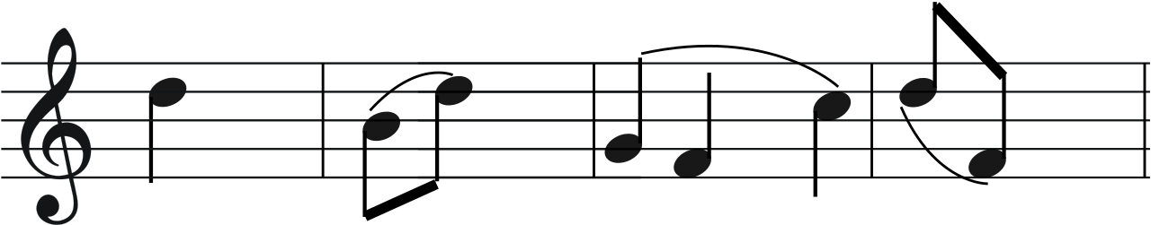
Contour tone languages
Beijing Chinese:
1. Mā / H ‘mum’
2. Má / R ‘cannabis’
3. Mǎ / LFR ‘horse’
4. Mà / F ‘to scold’
YouTube

Slide 22
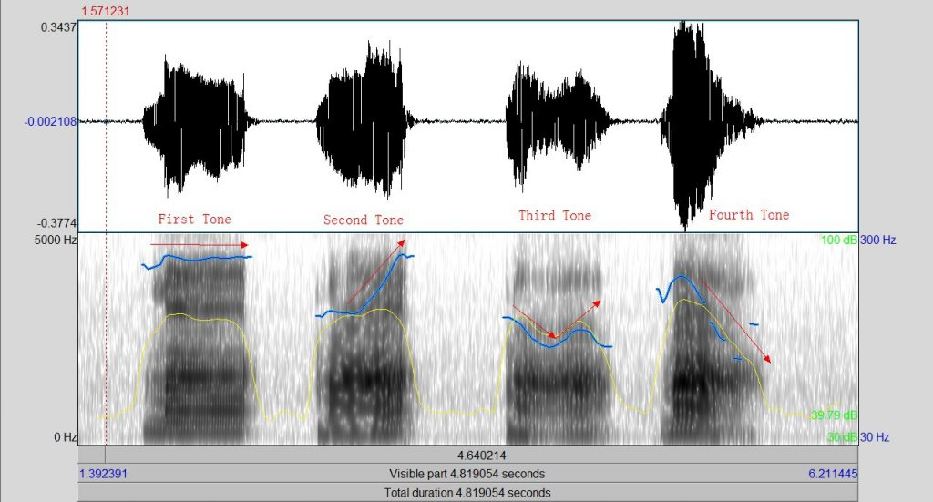
Beijing Chinese

Slide 23
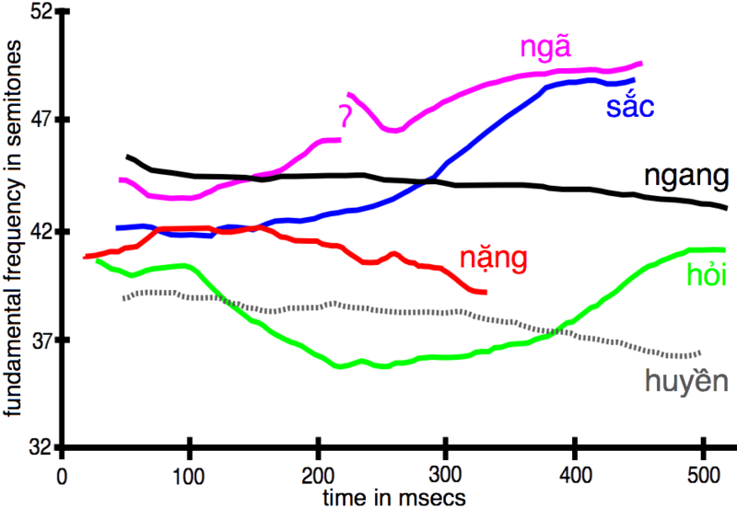
Vietnamese tones
Glottalized / breathy / modal voice
Long / short
YouTube
(Nguyễn & Edmondson 1998)

Slide 24
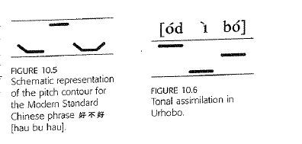
Context influence
(Ashby, Maidment 2005)
Declination
Voiced and voiceless consonants

Slide 25
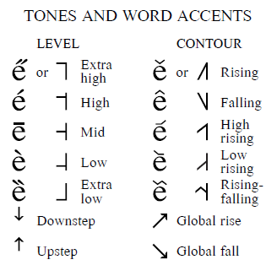
Transcription
5 = extra high
4 = high
2 = low
1 = extra low
[ba⁴²], [ba⁴²⁴]

Slide 26
Stress in lexical tone languages
Register tone languages usually have no stress: syllables are all equally prominent
Contour tone languages can have stress: there can be more tonal distinctions under stress
(compare with vowel reduction!)

Slide 27
Intonation
Pitch
Pauses
Division into parts
Prosodic stress
ToBI transcribing system
Janet Pierrehumbert

Slide 28
George’s shopping
Alright there! I got veg, meat, olive oil, water and honey. Can you hear me? What else do we need?

Slide 29
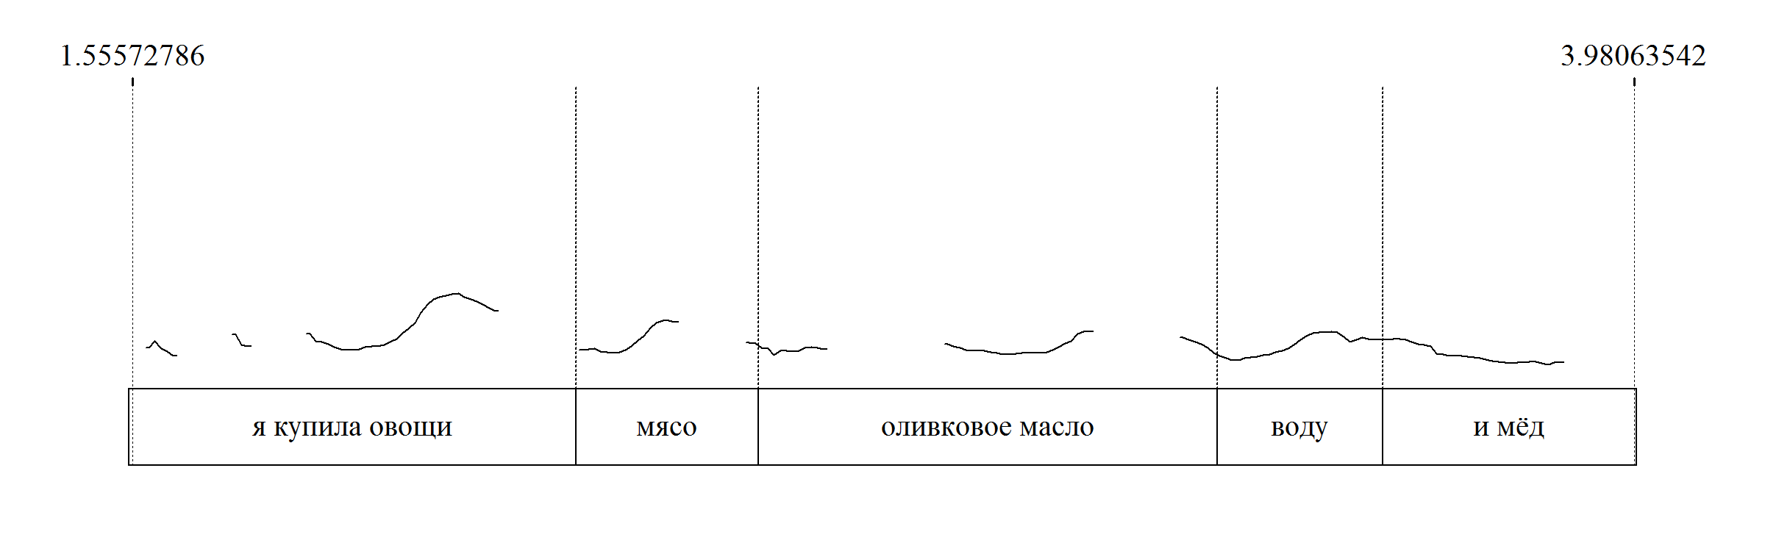
Russian

Slide 30
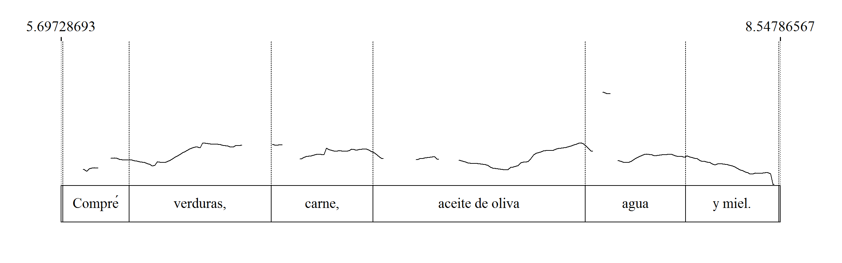
Spanish

Slide 31
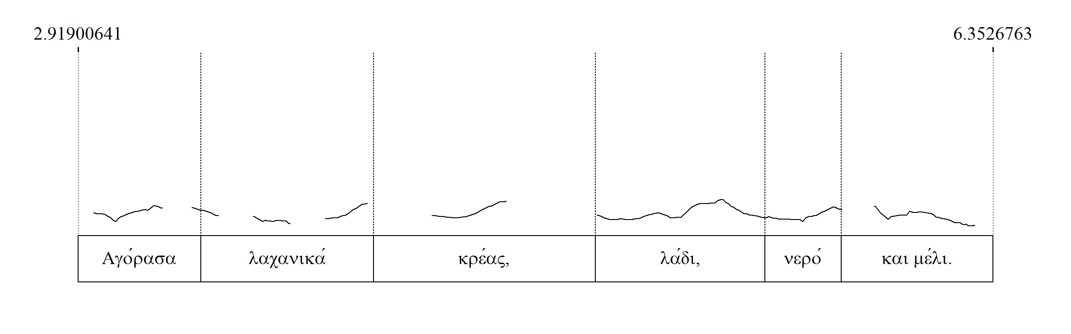
Greek

Slide 32
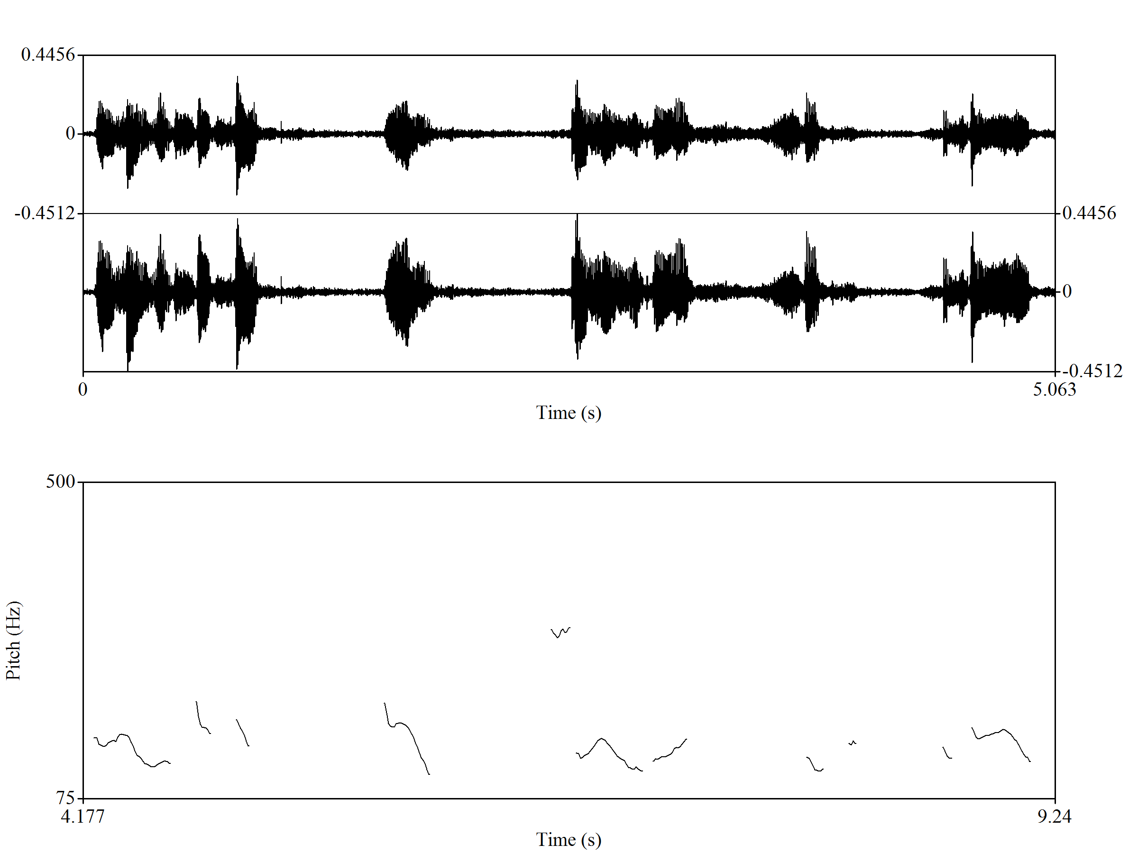
Chinese

Slide 33
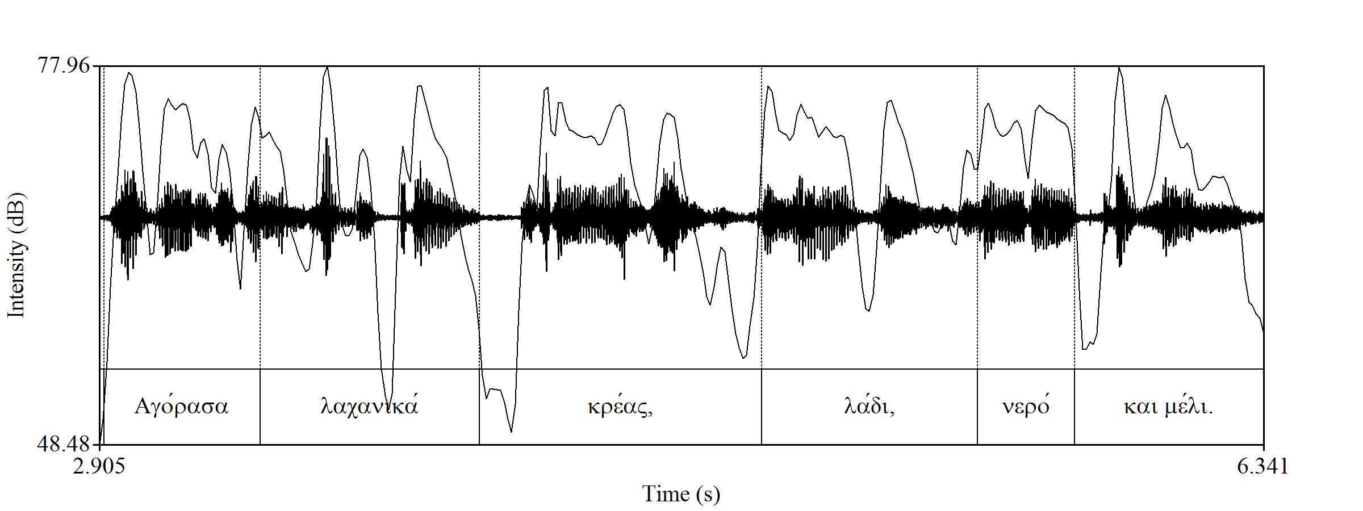
Intensity for Greek

Slide 34
Today:
Word stress
Lexical tones
Intonation
Types and descriptions
How to measure

Slide 35
What else?
Rhythm!
stress-timed, syllable-timed, mora-timed languages
measuring duration
Speech tempo
measuring the number of units
Describing prosody of a language
Second language acquisition
etc…

Slide 36
References
Maddieson I. 2013. Tone. In: Dryer, Matthew S. & Haspelmath, Martin (eds.) The World Atlas of Language Structures Online. Leipzig: Max Planck Institute for Evolutionary Anthropology. (http://wals.info/chapter/13)
Кодзасов С.В., Кривнова О.Ф. 2001. Общая фонетика. М.: РГГУ.
Maddieson I. 2010. Typology of phonological systems. In: Song Jae Jung (ed.) The Oxford Handbook of Linguistic Typology. Oxford University Press.
Ashby M., Maidment J. 2005. Introducing Phonetic Science. Cambridge University Press.
Yip M. 2002. Tone. Cambridge University Press.
Nguyễn, Văn Lợi; Edmondson, Jerold A (1998), "Tones and voice quality in modern northern Vietnamese: Instrumental case studies", Mon-Khmer Studies, 28: 1–18

Slide 37
More on tones:
Gandour, Jackson. 1978. The perception of tone. In Fromkin 1978: 41–76.
Hyman, Larry. 1975. Phonology: theory and analysis. New York: Holt, Rinehart & Winston.
Hyman, Larry. 2007. Universals of tone rules: 30 years later. In Tomas Riad, Carlos Gussenhoven (eds.). Tones and tunes. Berlin: Mouton de Gruyter.
Hyman, Larry. 2011. Tone: is it different? In John Goldsmith, Jason Riggle, and Alan C. L. Yu (eds.). The Handbook of Phonological Theory, Second Edition. Blackwell.
Hyman, Larry & Russel Schuh. 1974. Universals of tone rules: Evidence from West Africa. Linguistic Inquiry 5: 81-115.
Maddieson, Ian. 1978. Universals of tone. In Universals of Human Language; Volume 2 Phonology (ed. J.H. Greenberg et al.). Stanford University Press, Stanford: 335-363.
Maddieson, Ian. 2005, 2011. Tone. Chapter 13 in World Atlas of Language Structures, and World Atlas of Language Structures Online.
Pike, Kenneth L. Tone languages: A technique for determining the number and type of pitch contrasts in a language. University of Michigan Publications in Linguistics 4. Ann Arbor, MI. 1948.
Wedekind, Klaus. 1985. Thoughts when drawing a map of tone languages. Afrikanistische Arbeitspapiere 1: 105-124.
Welmers, William. E. 1959. Tonemics, morphotonemics, and tonal morphemes. General Linguistics. 4.1-9.
Yip , Moira. 2002. Tone. Cambridge: Cambridge University Press.
Zhang, Jie. 2001. The Effects of Duration and Sonority on Contour Tone Distribution – Typological Survey and Formal Analysis. PhD Dissertation, UCLA.
Maria Konoshenko

